Slide 1
A.I. & Discrimination
By: Aguibou, Alejandro, Autumn, Chante, and Raunak

Slide 2

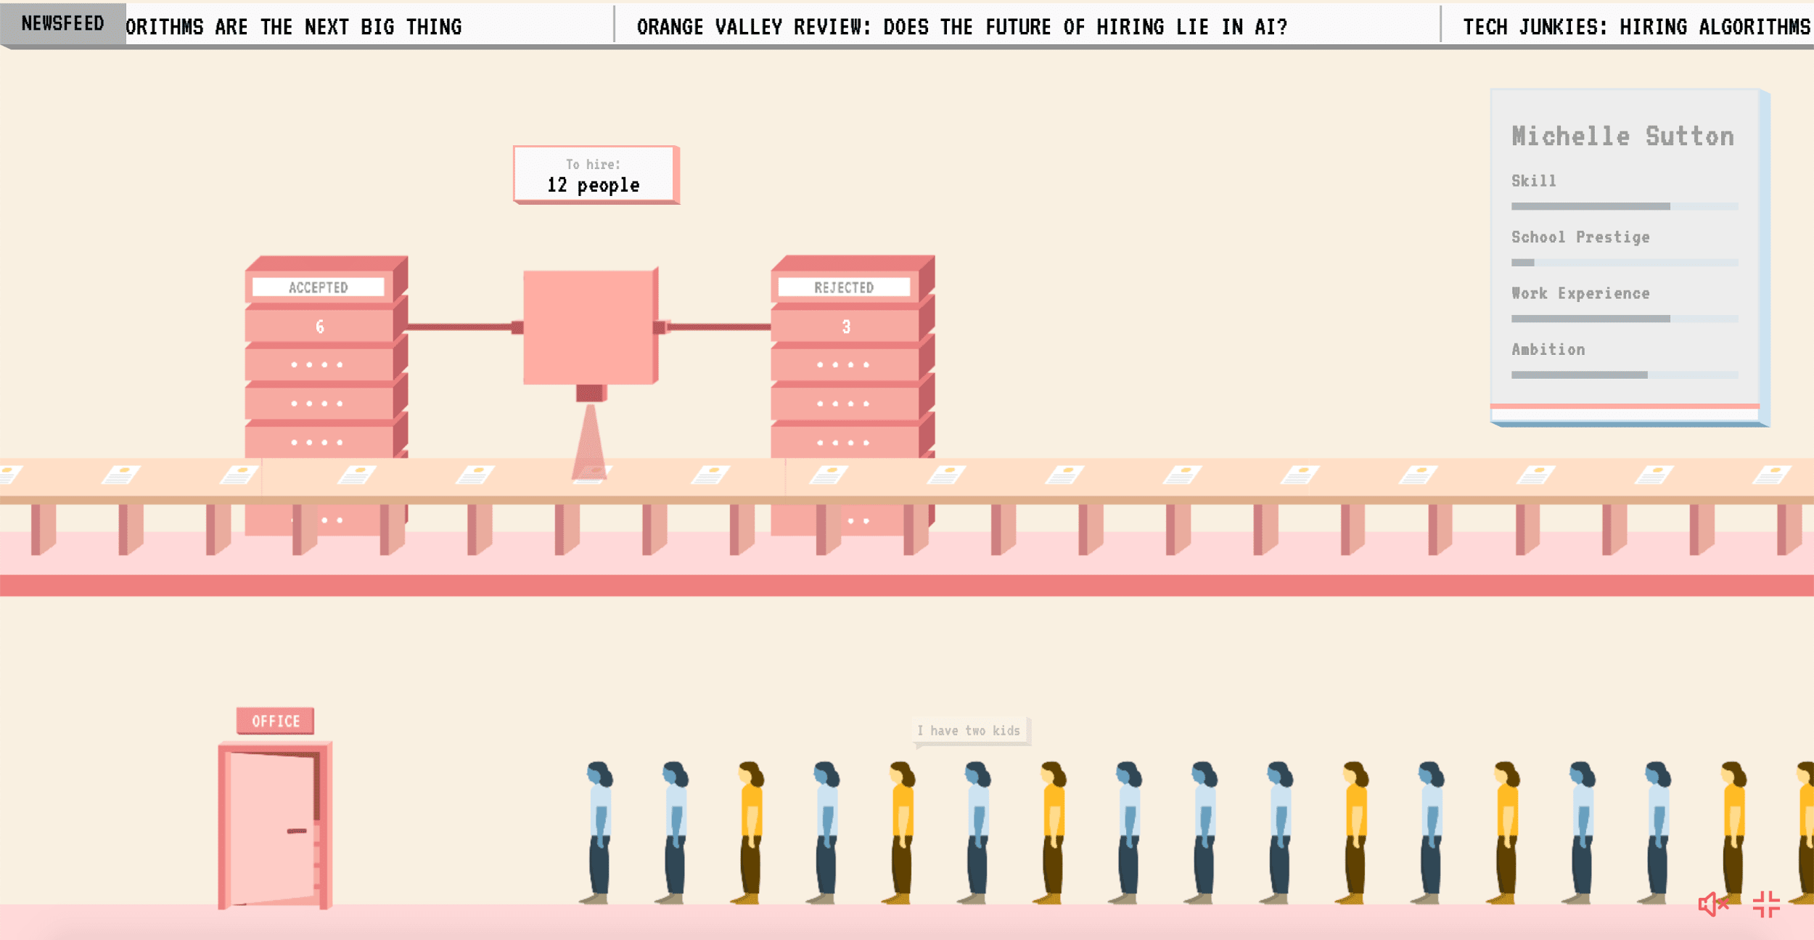
Why AI in Discrimination?
What’s Going on in the World? Racism and Police Brutality
Hiring Discrimination Game
We Can Make a Change
Notes:
One of the reasons we chose this topic is because of what has been going on in the world about racism and police brutality. However, what really motivated us to do this project was based off a hiring game we played as a group. By the end of the game we noticed how biased AI is when it comes to hiring due to their analysis on previous employers. All of us wanted to change this biased way of employing, and wanted to make a system that is more fair when hiring various people.

Slide 3

Biased Hiring in Real World Scenarios
Biased hiring is often seen when algorithms are used…
Discrimination in the Job Market in the United States | The Abdul Latif Jameel Poverty Action Lab
but, human biases are the root cause, shown in the many cases of biased, human, hiring.
How blind auditions help orchestras to eliminate gender bias
Notes:
Discrimination in hiring and the workplace can seem distant at times, especially to those that have not experienced it firsthand. However, it is a very real issue, and a very difficult issue to solve. The world has advanced to a point where the speed at which hires need to be made makes it near impossible for a human employer to keep up. Thus, more and more often, artificial intelligence and machine learning programs are being used to speed up the process. A recurring issue that has come up is the fact that employers can not seem to keep bias out of the program. Whether its human bias, or bias that is unintentionally created in the algorithm, minorities and women are consistently discriminated against throughout the workplace.

Slide 4

Background
Artificial Intelligence is being used in the hiring process
Factors include:
Biased data
Biased variables
Biased decisions
Notes:
Chante:
Artificial Intelligence is starting to be used in the hiring process. But, with AI, machines work to replicate human decision making. Often the bias in AI systems is the human behavior it emulates. When employers seek to simply automate and replicate their past hiring decisions, rather than hire based on a rigorous analysis of job-related criteria, this can perpetuate historic bias.
Biased data is data used to train algorithms may introduce bias.
Biased variables. Variables considered by algorithms often contain bias, and models may learn to use proxies for protected characteristics. For example, zip codes can be a proxy for race. Selecting biased variables can reflect developers’ blind spots—an acute concern considering the lack of diversity in the field.
Biased decisions. Humans may misuse models’ predictions and place undue weight on them, leading to discriminatory decisions.

Slide 5

The Negative Effects of Hiring Bias
Less diverse workplace
Hurts reputation of businesses
Men are 3.3 times more likely to be shortlisted
Notes:
Using statistical analysis , it can be established that there IS a substantial gap between expected and observed number of applicants that are being shortlisted. The major factors on being hired seem to include, ethnicity, gender and social status
In summary , MALE applicants are almost 3 times more likely to be hired than female applicants.
Having a diverse population in a workplace is important because different people provide new ideas and experiences, people can learn from each other, and creativity in the workplace will soar.

Slide 6

Possible Impacts of This Project
Companies realize personal biases
Eliminate discrimination in the hiring process
Provide a diverse workplace to employees
Data analysis and computer programming
Notes:
Chante:
The impact of our project would be to allow companies to realize their personal biases and change their way of hiring. Our project could be used to eliminate discrimination in the hiring process. The workplace could also have a more diverse setting which could lead to more ideas and more perspective. The fields in CS that our project would be under are data analysis and computer programming.

Slide 7
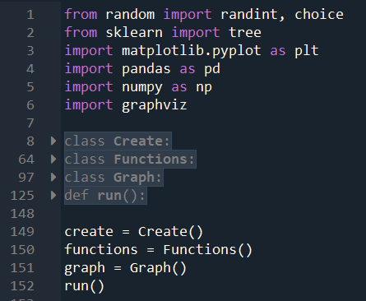
Algorithm
Generate a biased dataset and an unbiased dataset
Train and test the algorithm
Designed to make hiring decisions
Analyze potential bias in results
Graphs
Goal of the Algorithm:
Does bias in an algorithm’s training affect its decisions?
Notes:
The purpose of the algorithm was to input data, clean it, output a series of graphs up to human interpretation and also to create some simple conclusions based on the data.
New: This is an algorithm designed to generate a synthetic dataset and attempt to hire applicants without bias.

Slide 8
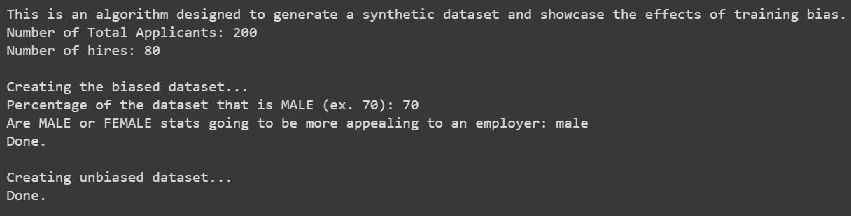
Generating the Datasets
The program proceeds to ask if the user would like to view the datasets, which dataset the user would like to use to train the algorithm, and to create graphs analyzing the algorithm’s decisions.

Slide 9
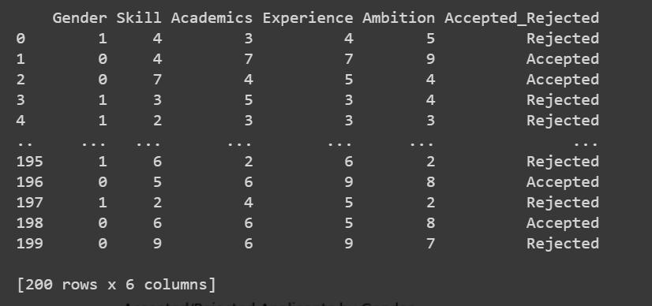
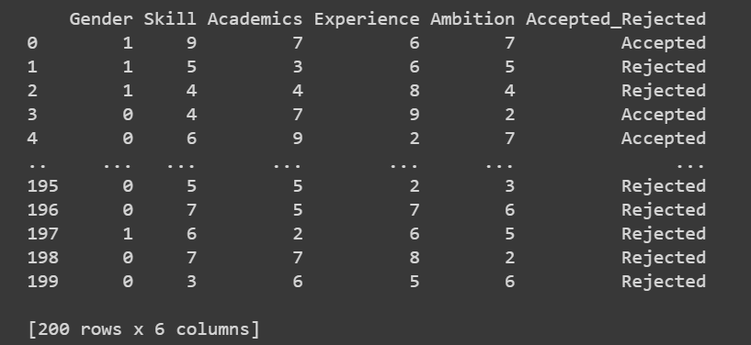
Dataset Used
Biased Dataset
We used our algorithm to create a synthetic dataset of fake job applicants with the following stats: gender, skill, academics, experience, and ambition. The overall parameters of the dataset are decided by the user. We chose this method because we couldn’t find an optimal dataset.
Unbiased Dataset
In the pictures above, in gender the number 0 indicates male and 1 indicates female.
Notes:
Due to the lack of suitable datasets, we created one using an algorithm which focused hired people based on gender, skill, academics, experience and ambition.

Slide 10
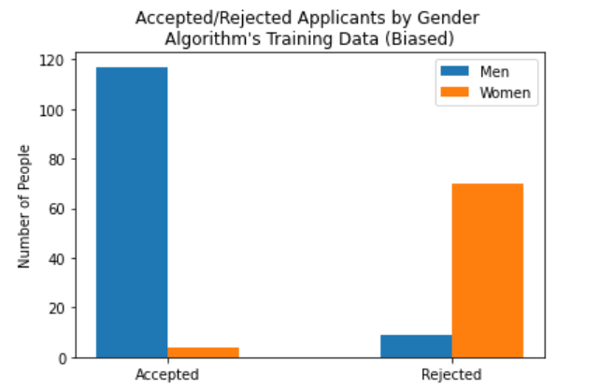
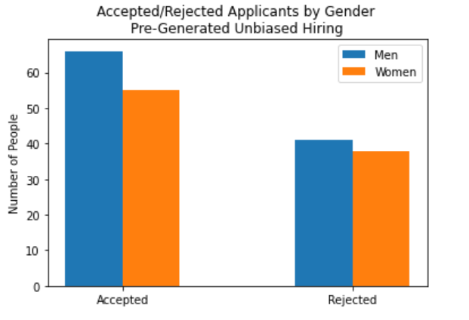
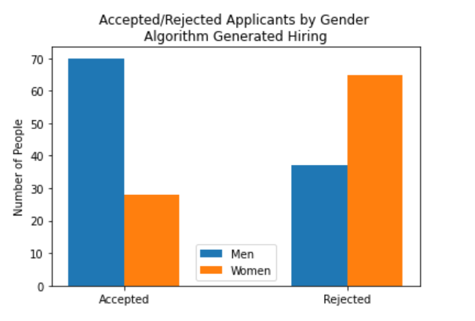
Analyzed Data:
Fig. 1 Trained on bias data and had more bias towards men
Fig. 2 Tested with unbiased data, less bias
Fig. 3 Final data had more bias towards men
Although the algorithm was tested unbiased data (Fig. 2), because it was trained on biased data (Fig. 1), the final results (Fig. 3) showed the prevalence of the training bias
Notes:
The first graph was used to train the data which was intentionally bias due to men being more desired for a job than women.
The second graph was made to be and example of unbiased data which is going to be compared to the third graph
The third graph is what was generated by the AI which was shown to be less bias than the first graph but more bias than the second graph which indicated that bias was still being showed.
There was seen to be a much more bias towards men in the first graph
In the second graph, there was less bias than on the first graph
In the third graph, which is what the AI generated, shows bias towards men due to being trained on bias data
These highlight the effects of training bias in machine learning
The algorithm’s decisions (graph 3), showed bias towards the male gender even though the dataset those decisions are based on was unbiased (graph 2)
This is because of training bias; the algorithm was trained on the biased data (from graph 1) and therefore showed bias in its final decisions

Slide 11

Possible Expansions Upon This Project
Help employers conduct an AI that will make unbiased decisions in the hiring process.
Feedback from various people, to create more spread out data instead of a specific type.
Anonymous resumes
Notes:
This algorithm can be altered in many ways. The purpose of the algorithm is meant to help employers hire quickly and fairly. For example, the alterations can include: Feedback from various people, instead of just one person to create more spread out data instead of a specific type, . anonymous resumes, so that the computer can use unbiased information to hire a more diverse population. These would be further expansions done to our algorithm. Thank you!

Slide 12
Sources
Yang, J. (2020, February 12). Three Ways AI Can Discriminate in Hiring and Three Ways Forward. Retrieved July 17, 2020, from https://www.urban.org/urban-wire/three-ways-ai-can-discriminate-hiring-and-three-ways-forward
Sambit78. (2019, May). Recruiting Bias Analysis. Retrieved July 17, 2020, from https://github.com/Sambit78/People-Analytics-Project/tree/master/05%20-%20Recruiting%20Bias%20Analysis.
Das, S. (2019, April 13). Exploring Recruitment Bias using Machine Learning and R. Retrieved July 17, 2020, from https://towardsdatascience.com/exploring-recruitment-bias-using-machine-learning-and-r-8e071dad7dce

